Slide 1

Financial Fraud Detection Using Machine Learning
Leveraging advanced analytics and machine learning to safeguard financial transactions and protect against sophisticated fraud schemes in real-time digital payment systems.
MOHIT KUMAR SBU232941

Slide 2
Problem Statement
The Challenge
Business Impact
Financial institutions process millions of transactions daily, with fraudulent activities causing billions in annual losses. Traditional rule-based systems struggle to detect sophisticated fraud patterns that evolve rapidly.
Key challenges include:
Highly imbalanced datasets (fraud cases < 0.1%)
Real-time detection requirements
Adapting to new fraud tactics
The stakes are exceptionally high for modern payment ecosystems. As digital transactions proliferate, fraudsters develop increasingly complex schemes that exploit system vulnerabilities faster than legacy detection methods can adapt.
Minimizing false positives
Regulatory compliance pressures
Customer experience preservation
$32B
0.06%
99.9%
Global Fraud Losses
Fraud Rate
Legitimate Transactions
Annual financial losses from payment fraud worldwide
Percentage of fraudulent transactions in typical datasets
Must be processed without disruption

Slide 3

Project Overview
This project implements an end-to-end fraud detection system that combines streaming data infrastructure, distributed computing, and advanced machine learning algorithms. The solution addresses the critical need for real-time fraud identification while maintaining high accuracy and minimal false positive rates.
Our approach integrates industry-leading technologies to create a robust, scalable platform capable of processing millions of transactions daily. By leveraging ensemble learning techniques and sophisticated feature engineering, the system adapts to evolving fraud patterns while providing actionable insights to fraud analysts and automated response systems.

Slide 4
Project Description
01
02
03
Data Ingestion & Preprocessing
Exploratory Analysis
Feature Engineering
Real-time transaction data is captured via Apache Kafka streaming, then processed through PySpark for distributed data cleaning, normalization, and feature extraction at scale.
Comprehensive analysis using Python libraries to identify fraud patterns, statistical anomalies, and transaction type distributions across millions of records.
Creation of sophisticated features including velocity metrics, balance differentials, time-based patterns, and behavioral indicators to enhance model performance.
04
05
Model Development
Real-time Monitoring
Implementation of ensemble machine learning algorithms including Logistic Regression, Random Forest, and XGBoost with hyperparameter tuning for optimal fraud detection.
Deployment of trained models with Power BI dashboards for continuous monitoring, alerting, and visualization of fraud detection metrics and suspicious activities.

Slide 5




Technical Architecture
System Components
End-to-end fraud detection pipeline integrating multiple technologies for seamless operation:
Kafka Streaming
Handles high-throughput transaction data ingestion with fault tolerance and low-latency processing capabilities. Ensures zero data loss during peak transaction volumes.
PySpark Processing
Distributed computing framework for large-scale data transformation and feature engineering operations. Enables parallel processing across cluster nodes.
ML Framework
Python-based ecosystem with Scikit-learn for model training, Pandas and NumPy for data manipulation, enabling sophisticated algorithm development.
Power BI Analytics
Interactive dashboards providing real-time fraud insights and operational metrics for stakeholders, fraud analysts, and compliance teams.

Slide 6





Software Requirements
Python 3.8+
Core programming language for data processing, ML model development, and pipeline orchestration.
Pandas & NumPy for data manipulation
Scikit-learn for ML algorithms
Matplotlib & Seaborn for visualization
Machine Learning Stack
Advanced algorithms for classification and anomaly detection tasks.
Logistic Regression for baseline modeling
Random Forest for ensemble learning
XGBoost for gradient boosting
SMOTE for handling class imbalance
Apache Kafka
Distributed streaming platform for real-time data pipeline management and message queuing.
High-throughput data ingestion
Fault-tolerant message delivery
Scalable architecture
PySpark
Big data processing engine enabling distributed computing for large-scale datasets.
Spark SQL for data queries
MLlib for distributed ML
DataFrame operations at scale
Power BI
Business intelligence platform for creating interactive dashboards and real-time monitoring systems.
Real-time fraud alerts visualization
Performance metrics tracking
Stakeholder reporting

Slide 7

Hardware Requirements
Development Environment
CPU: Intel i7 or AMD Ryzen 7 (8+ cores)
RAM: 32GB minimum for data processing
Storage: 1TB SSD for dataset storage
GPU: NVIDIA RTX 3060+ (optional, for deep learning)
Production Cluster
Distributed Spark cluster (4-8 nodes)
Kafka brokers with redundancy
Load-balanced API servers
High-availability database systems
Scalable infrastructure designed to handle millions of transactions per day with sub-second latency requirements and 99.9% uptime guarantees.

Slide 8



Machine Learning Algorithms
Our fraud detection system employs multiple classification algorithms, each bringing unique strengths to the ensemble approach. This multi-model strategy ensures robust performance across diverse fraud patterns.
Logistic Regression
Provides interpretable baseline model with probability scores. Fast training and inference make it ideal for real-time scoring. Excellent for identifying linear relationships in fraud indicators.
Random Forest
Ensemble of decision trees that captures complex non-linear patterns. Handles feature interactions naturally and provides robust feature importance rankings for fraud analysis.
XGBoost
Gradient boosting framework that achieves superior accuracy through iterative learning. Optimized for imbalanced datasets with built-in regularization to prevent overfitting.

Slide 9
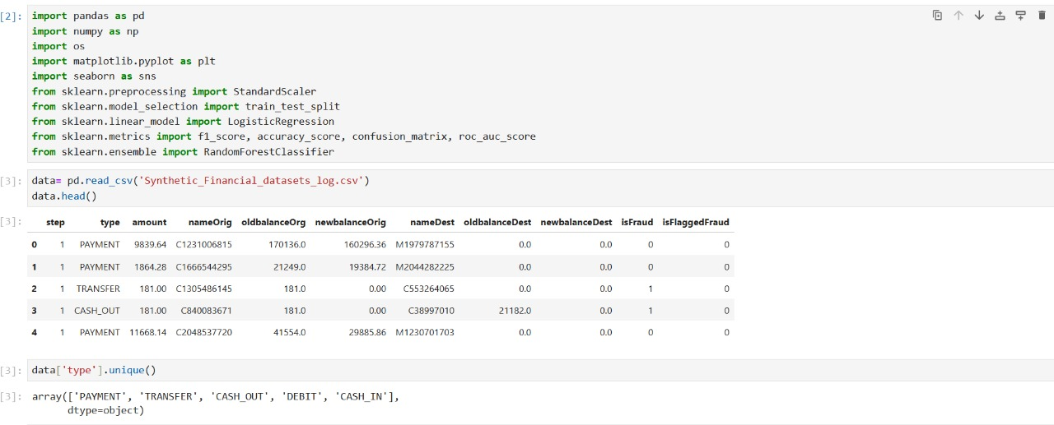
Dataset Overview
Key Observation: Analysis reveals that 99.87% of fraud cases occur exclusively in TRANSFER and CASH_OUT transaction types, making these categories critical focal points for detection algorithms.

Slide 10



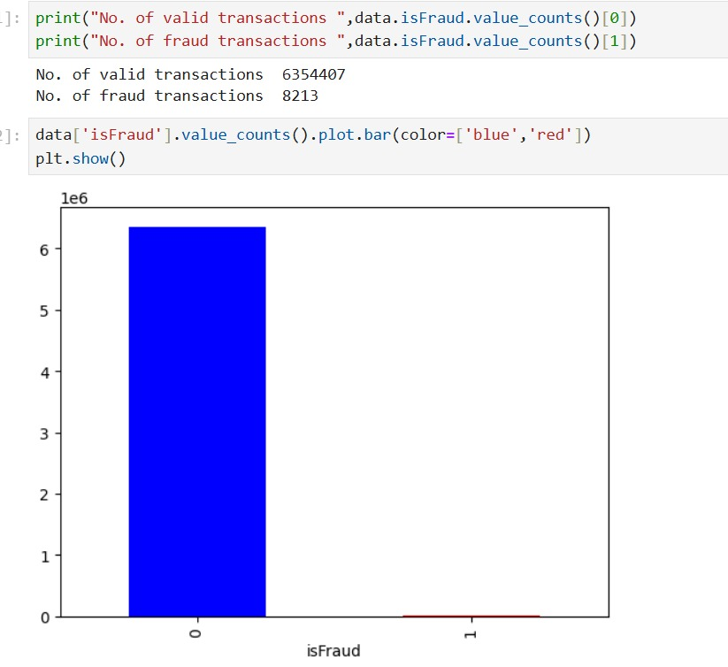
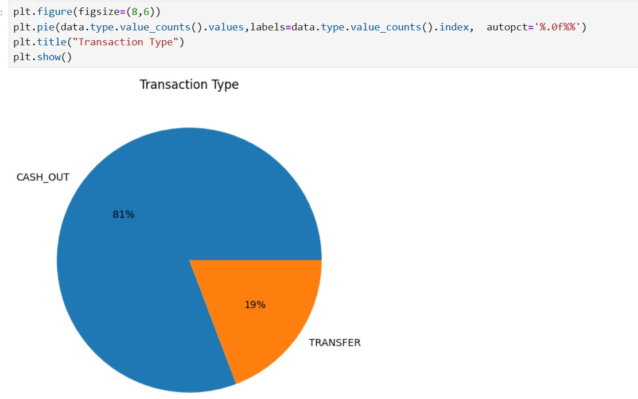
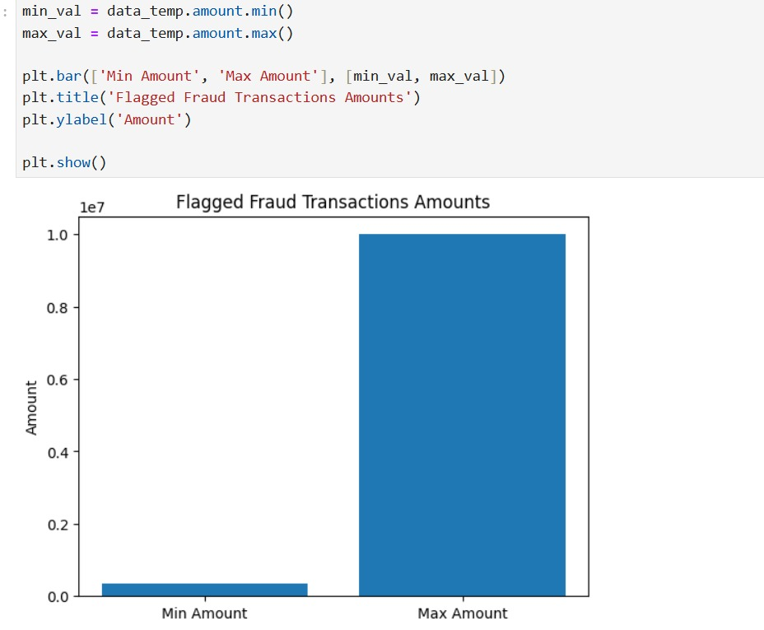
Fraud Pattern Discovery
High-Risk Transactions
Deep analysis uncovered distinctive behavioral patterns that serve as powerful fraud indicators:
Immediate Cash-Out Pattern
Balance Manipulation
High-Value Anomalies
Fraudsters execute large TRANSFER operations followed immediately by CASH_OUT, often within the same time step, to quickly extract and convert stolen funds before detection systems can respond.
Anomalous balance transitions where sender accounts drop to zero while receiver balances show unexpected or impossible values, indicating system exploitation and account compromise.
Sudden spikes in transaction amounts far exceeding historical account activity patterns, often targeting dormant or newly compromised accounts with unusual velocity.

Slide 11
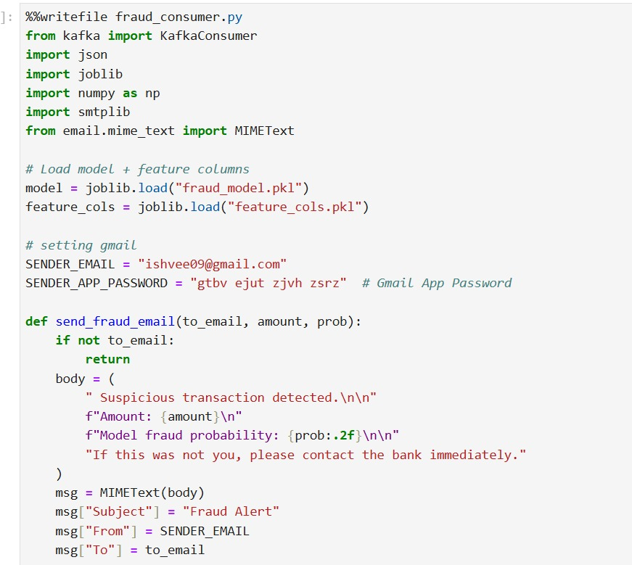
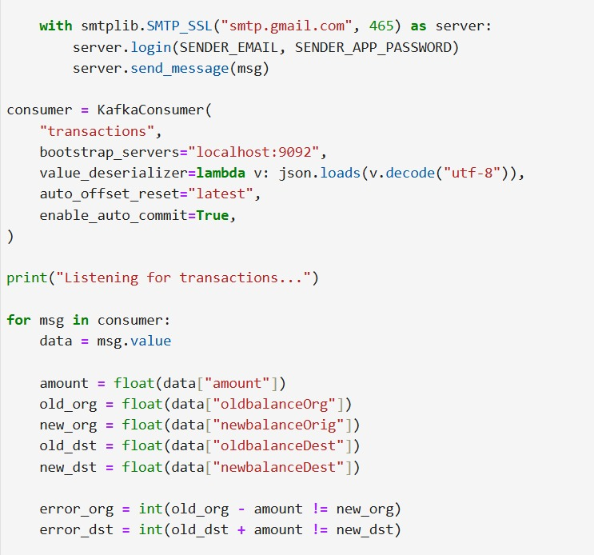
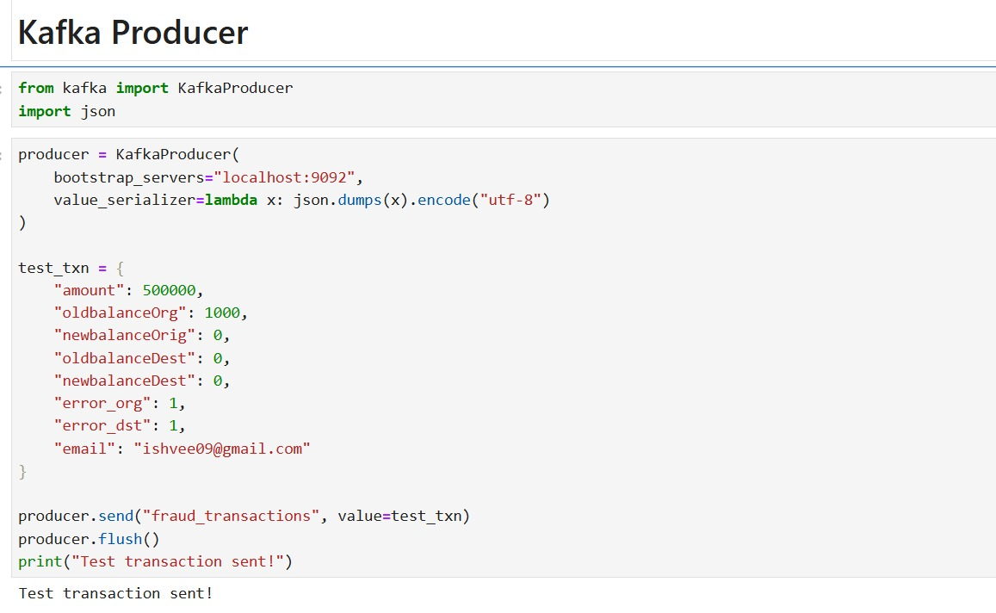
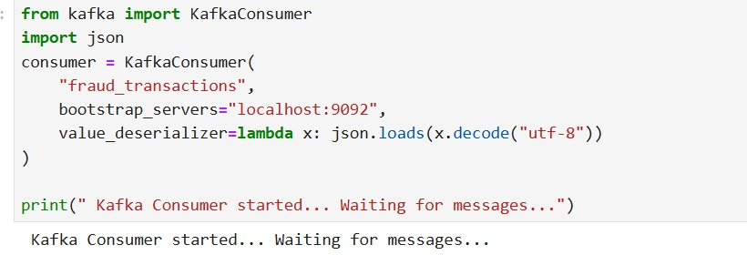
Kafka and Pyspark integration Overview

Slide 12

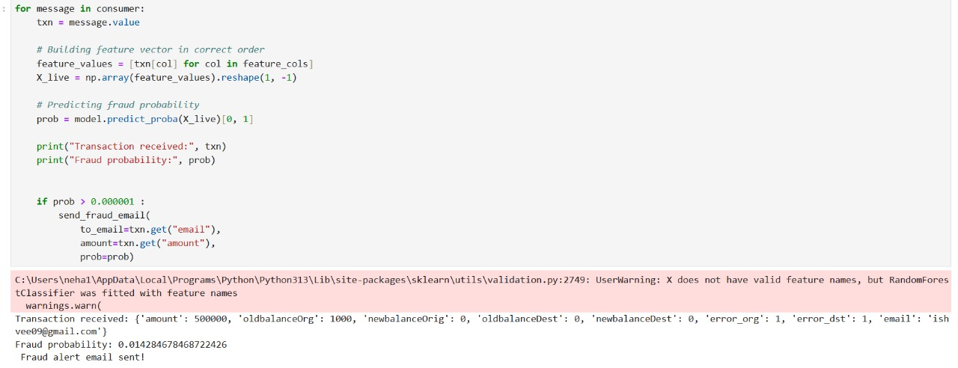
Sending alerting email

Slide 13
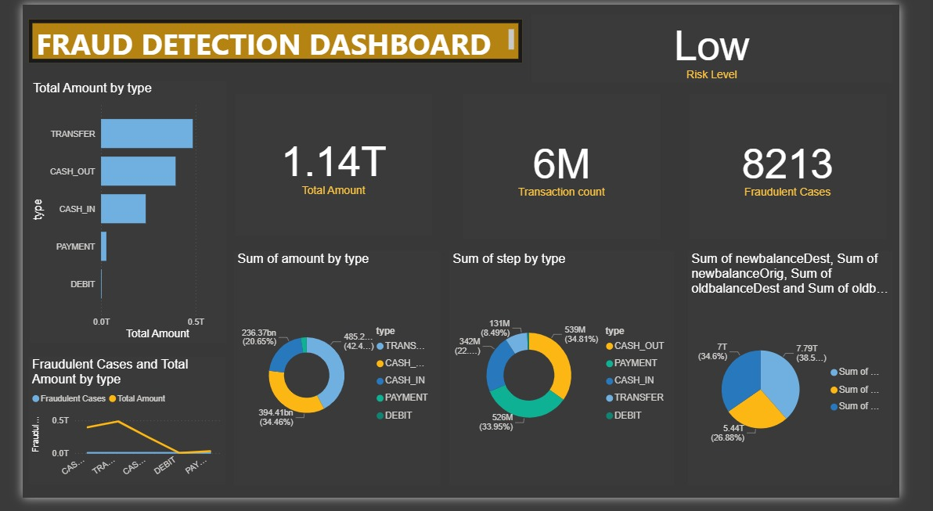
POWER BI DASHBOARD OF FINACNIAL FRAUD DETECTION

Slide 14

Thank You!
We appreciate your time and interest in our Financial Fraud Detection system. We are confident this solution will provide robust protection against financial crime.

